Slide 1
Haystack:
A Customizable General-Purpose Information Management Tool for End Users of Semistructured Data
David Karger

Slide 2
Motivation

Slide 3
Truism
People should be able to
  Record the information they care about
  Find it when they need it
  Easily understand it when shown
  Easily manipulate it

Slide 4
Applications
Focused on a specific domain
  Email
  Photos
  Calendar
  Architecture
Specific data model
  Basic objects, relationships, attributes
Interfaces to view and navigate
Controls to record, manipulate
Search tools to find what’s wanted

Slide 5
Problems
Users discover uses/needs for other info
  Tool cannot store, cannot support interaction
Users discover connections between info
  If connected info is in different applications, neither app can record connection
User tasks span applications
  Bits of what I want in many different applications
  Can’t see all at once
  Parts I want lost among distractions
  Lots of context switching overhead
  Primitive tools (select/cut/paste) to extract what I need

Slide 6
Contrast the Web
Uniform data model:
  Any object can be represented by a web page
  Any objects can be linked/related
Uniform interface
  Web browser
  Common presentation customs (menu bars, etc)
Powerful navigation tools
  Web search engines
  Links used to orienteer from item to related item, homing in on what you want

Slide 7
Problems
Individuals don’t store own info in html---why?
Web is “read only”
  Hard to create or edit web pages
  Someone has to invest the effort
Not machine readable
  Must be consumed by human being
  Can’t use applications’ sophisticated operations on data
  (Web sites offer operations, but only on own data)

Slide 8
Challenge
Allow users to
  Record any information objects they care about
  Record arbitrary relationships and attributes connecting those objects in arbitrary ways
  See those relationships in easy-to-understand ways
    May depend on what the user is doing
  See in one place all the information needed to accomplish a given task
  Apply applications’ complex manipulation tools to the data they have recorded
Every user will want to do this differently

Slide 9
Data Model

Slide 10
The Haystack Data Model
W3C RDF/DAML standard
Arbitrary objects, connected by named links
  A semantic web
  Links can be linked
No fixed schema
  User extensible
  Add annotations
  Create brand new attributes
HTML
type
title
Doc
Haystack
quality
author
says
D. Karger
Outstanding

Slide 11
RDF? XML? RDB?
All have same representational power
But suggest different focus of attention
RDB
  Schemata, tuples
  complex queries
XML
  hierarchical representation, focus on roots
  Path queries
RDF
  all info equally important
  (binary) relations as links between objects
  web-like associative navigation, trivial queries

Slide 12
Visualization

Slide 13
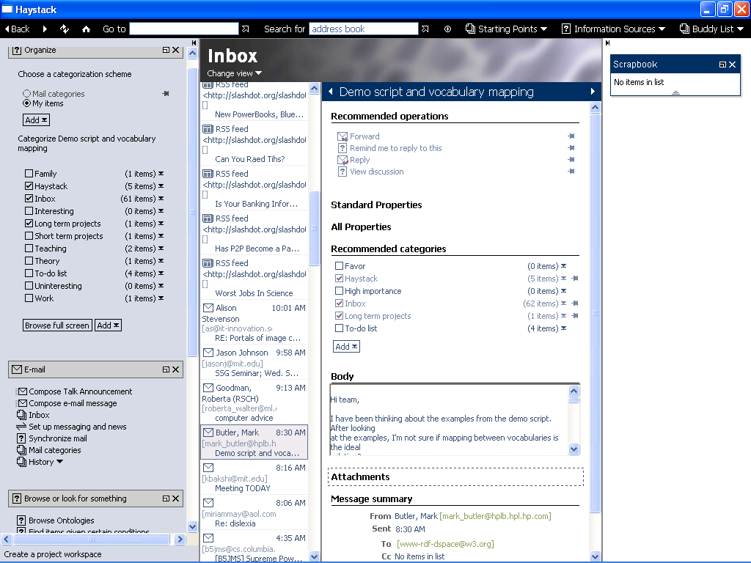
The Big Picture

Slide 14
Information-Centric Rendering
Problem: if can link arbitrary objects, application can’t predict what it will have to show
And, might not know how to show it
Solution: objects render themselves
  “To display a document, show the title above the author above the body”
  “To display an author, show the name above the address above the phone number”
  In general, to render an X, look up certain properties, and lay out their (recursive) renderings a certain way

Slide 15
View Prescriptions
Describe how to render a certain type of object
  Look up certain related objects, render them
  Lay out those renderings, along with various decorations (borders, icons, textual labels) and widgets (scroll bars, buttons)
Different views for different circumstances
  E.g. one-line view, medium-sized view, full view
Haystack UI responsible for choosing, invoking best prescription fitting type of object to be shown
Views are described in RDF
  So are persistent, manipulable data in the system

Slide 16
Benefits
Any object can be displayed anywhere
  Object not limited to being in specific applications
  Applications not limited to showing only certain types of object
Same view used in many different contexts
  Enhances uniformity, predictability of interface
  Customizations of view propagate to all uses of it
Easy to incorporate new data types
  Craft view for that data type,
  It appears embedded among other views
View descriptions often simple enough for end-user customization [current work]
  Choose which related items to show
  Visually edit layout

Slide 17
Multiple Views are Useful
Can give best presentation for current task
But always be operating on same data
E.g., views for collections
  Summary view for browsing
  Tabular view for careful scanning
  Graph view to show relationships between members
  Calendar view to show date dependencies
  Menu view for drop-down selection
  Check-box view for putting items into collections

Slide 18
Manipulation

Slide 19
Operations
Functions that act on data in the model
  Relations specify argument types and code to invoke
  Inverse relation lists operations for given type
  Because data is machine-readable, operations can be complex
Everything on screen is rendered views
  So everything visible represents object in model
Use click, drag-and-drop, and context menus to invoke operation
  Can invoke any operation in place

Slide 20
Invoking Operations
Right click produces context menu of all operations relevant to type of clicked object
  One-arguments operation invoked on selection
  Otherwise, dialog box opens to collect other args
    User can navigate haystack, find args, drag to dialog
    Providing right arguments is information retrieval task
Drag and drop invokes (type-specific) “main” op
  E.g. dropping on a collection invokes “add to it”
Operations are data (stored in RDF model)
  Create or edit groups of them in menus
  Search for them
  Customize them by grabbing partially filled dialog boxes

Slide 21
Tasks
What user sees, and how they see it, should depend on what user is trying to do
  Traditionally achieved by applications
Haystack materializes tasks in the data model
  asserts that certain objects, operations, views are germane to a given task
E.g., if doing email
  Inbox should be easily accessible
  View of person should include email from them
  “Get new mail” should be easy to invoke
User can customize

Slide 22
Search

Slide 23
Focus on simple methods
Hyperlinking paradigm
  Left click on any item browses to it
  Supports users’ preference for orienteering: starting and a familiar place and following association chain to item
Text search
  Using text-valued attributes of objects
  Text-search for commands spans gap between menus and command line
“Similar item” browsing
  Treat object as “document” with related items as “words”, apply text-search techniques

Slide 24
Complex Searches
Haystack has primitive query builder to create database queries against the underlying model
But use is a sign of failure
  End users aren’t sophisticated enough
Instead, wrap powerful queries in operations
  invoked by user in standard way
  parameters collected in standard dialog box

Slide 25
Customization

Slide 26
Who customizes
Some customization well within scope of all users
  Choosing properties to display in a list view
  Partially filling in a dialog to create new operations
Others require power users
  Complex layouts
  Composing operations (macros)
But all customizations are data
  Power users can create and then share
  Users can download new views, operations
    Like new skins for MP3 players

Slide 27
Proof of Concept
Mygrid project
  Consortium developing tools for bioinformatics research
Downloaded haystack, created “bio-haystack”
  Specialized views of genome sequences
  Operations invoke bioinformatics web services like BLAST
Almost no support from Haystack group
Example of “end-user application creation”
  Domain expert better equipped than CS developer to invent best application for their domain
  Haystack removes need for software expertise

Slide 28
Open Issues

Slide 29
Semantic Web
Lots of web information exposed in HTML is backed by databases
If expose as RDF, Haystack can consume
End users
  Gain control over view of information
  Can incorporate it, operate on it
  Can blend information from multiple sites
  Can invoke, customize web services (as operations)
Conversely, users creating data in Haystack can publish to semantic web
  Many access-control questions

Slide 30
Role of Schemata
Benefits
  Help people look at information the right way
  Help creators avoid creation mistakes
Risks of Enforcement
  Deters lazy users from entering data
  Prevents creative users from stretching the boundaries
Is there a middle ground?
  Can schemata be “advisory”?
  E.g. “Type” used heavily to choose views, operations
One or many?
  If each user makes own schema, how translate?

Slide 31
Rich Client vs Web Browser
Getting users to adopt new client is hard
But everyone has a web browser
View architecture can render to HTML instead of pixels
  Fresnel---part of MIT SIMILE project
But for sophisticated info management, web browser interface too thin
Transition through applets? XUL?

Slide 32
Ready for End User?
UI ambiguity
  Which object being addressed by user?
  Need for pixel-level accuracy in drag and drop
What gets reified?
  When show list of authors, users assume collection exists
Protecting user from themselves
  Views, operations, schemas are data
  So by manipulating data, user can destroy their system
  How enforce access control at tuple level?
Performance
  Incredibly slow, probably doesn’t have to be

Slide 33
Group Members
Karun Bakshi
Dennis Quan
David Huynh
Vineet Sinha
Thanks to Joe Hellerstein for a last-minute read

Slide 34
More Info
http://haystack.csail.mit.edu/
(available for download)
karger@mit.edu

